Slide 1
TCP Refresher
Review of lectures 10-11

Slide 2
Transport-Layer Humor
I can tell you a joke about UDP, but I can't guarantee that you'll get it.
Of course, if you'd rather, I can tell you a joke about TCP. I can guarantee that you'll get it, but I might have to tell you more than once.

Slide 3
Transport Protocol Functions
At a minimum… (UDP)
Provide a way to deliver a message to a specific application at the destination host (IP doesn't provide this)
Allow multiple applications on a given host to have simultaneous access to network services ("multiplexing")
And also maybe… (TCP, in addition to the items above)
Guarantee delivery of message end-to-end, and retransmit if needed
Guarantee sequenced delivery (by numbering messages)
Prevent delivery of duplicate messages
Allow applications to send messages of unlimited size
Assure that sender and receiver are synchronized, i.e., connected, disconnected, etc. (maintain state)
Provide for end-to-end flow control and congestion control

Slide 4
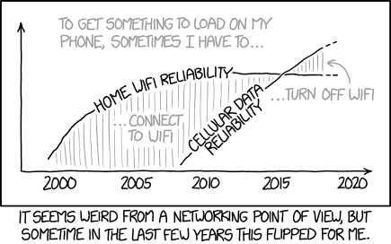
Transport-Layer Humor

Slide 5
State Information Maintained for Each Connection by TCP Endpoints
Connection state: closed, open requested, open, close requested, error conditions
Number of bytes transmitted & received (SequenceNum & Acknowledgement)
Available send and receive buffer space
IP address & port number for both endpoints
Retransmission timers
Current and average round trip time (for congestion control)
Other side’s current Advertised Window (for flow control)

Slide 6
State Transitions for TCP Connection Establishment (“Active Open”)*
(transmitted)
CLOSED
CLOSED
SYN_SENT
LISTEN
SYN_RCVD
ESTABLISHED
Figure 5.7 TCP state transition diagram
ESTABLISHED
Figure 5.6 Timeline for three-way handshake algorithm
*In TCP, the endpoint that opens the connection (sends the first SYN) is, by definition, the client.

Slide 7
State Transitions for TCP Connection Termination (“Graceful Close”)
Refers to Passive Open
ESTABLISHED
ESTABLISHED
FIN_WAIT_1
CLOSE_WAIT
Close/FIN+ACK
FIN_WAIT_2
FIN+ACK/ACK
LAST_ACK
TIME_WAIT
Figure 5.7 TCP state transition diagram
CLOSED
CLOSED
Standard TCP “graceful” close

Slide 8
Summary of Winsock TCP/Stream API Function Calls in C

